Slide 1

Towards Smarter Customer Retention
A Machine Learning Approach to ISP Churn Prediction in Kenya
Mary Asunta
Brian Mburu
Susan Maina
Jerome Juma
Kabira Timothy
Presented by:

Slide 2


Introduction
The Challenge
The Cost
Customer churn is a critical challenge for Internet Service Providers (ISPs). In Kenya's fast-growing and competitive ISP market, customers can easily switch providers due to price sensitivity, service quality, or customer support issues. High churn rates not only reduce immediate revenue but also undermines long-term investments in costly network infrastructure development.
Retaining existing customers is far more cost-effective than acquiring new ones. Studies in telecommunications demonstrate that effective churn prediction and retention strategies can save up to five times the cost of bringing in new subscribers. For ISPs operating in competitive markets, this makes churn management a strategic necessity rather than just a technical issue.

Slide 3




Introduction… cont…
Proactive Intervention
Machine Learning Power
This enables ISPs to implement proactive and targeted interventions, strengthening customer loyalty and retention rates significantly.
By analyzing customer behavior, demographics, and feedback patterns, predictive models can identify customers at risk of leaving before they actually churn.
Strategic Impact
Supporting broader goals of digital inclusion and sustainable economic growth across Kenya's telecommunications landscape.

Slide 4





Business Problem
Revenue Erosion
High churn erodes revenue and undermines customer lifetime value for Kenyan ISPs,
creating significant financial pressure.
Retention Economics
Retention is cheaper than acquisition, but accurately predicting churn remains a major operational challenge.
Key Churn Drivers
Critical factors include poor service quality, high prices, weak customer support, and changing usage patterns.
The Need
A predictive model to flag high-risk customers early and explain the underlying reasons why they churn.
Expected Impact
Lower churn rates, stronger customer loyalty, and sustainable competitive advantage in a crowded market.

Slide 5

Project Objectives
01
Develop ML Model
Build a supervised machine learning model to predict customer churn risk for Internet Service Providers using behavioral, transactional, and customer feedback data.
02
Enable Proactive Retention
Identify high-risk customers early to enable proactive retention strategies before customers actually leave the service.
03
Analyze Churn Patterns
Determine which customer segments exhibit the highest churn rates through comprehensive pattern analysis.
04
Identify Key Predictors
Pinpoint the most influential variables of churn across behavioral, demographic, and transactional dimensions.

Slide 6
Project Objectives… Cont.…
Evaluate Loyalty Strategies
Incorporate Sentiment Analysis
Provide Actionable Insights
Design practical retention strategies targeting high-risk customer profiles with data-driven recommendations.
Leverage customer feedback through sentiment analysis to improve prediction accuracy and understand customer emotions.
Assess the effectiveness of existing loyalty programs and retention initiatives in keeping customers engaged.

Slide 7
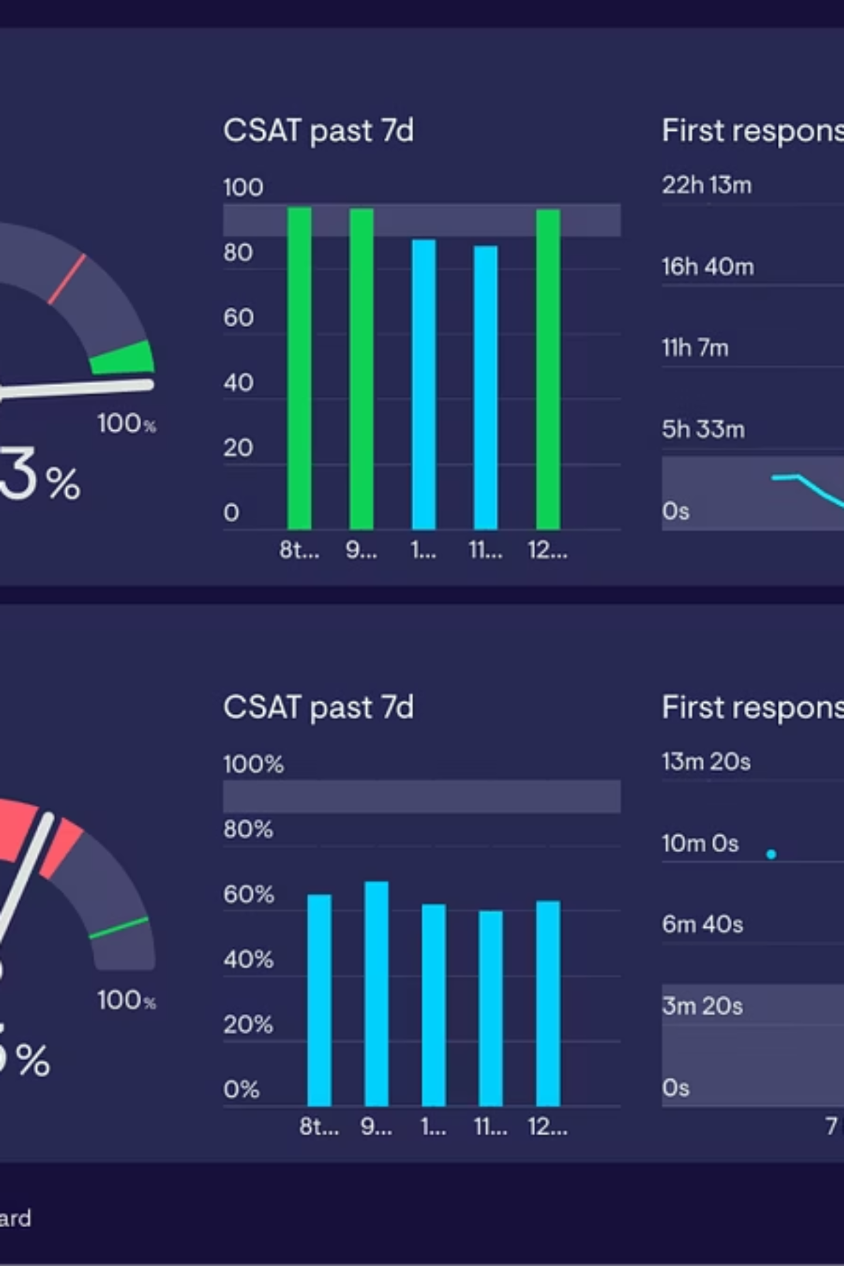


Data Source
Dataset source
The dataset is sourced from Hugging Face's Customer Churn Dataset; a comprehensive collection designed for churn prediction research.
Dataset Scale
Contains 36,992 customer records with 23 features in CSV format, providing substantial data for model training and validation.
Data Composition
The dataset combines both structured and unstructured data, covering multiple dimensions of customer information. It includes customer demographics such as age, gender, and region; subscription details like membership category and internet option; behavioral indicators including average time spent and days since last login; and customer interactions such as complaints, feedback, and churn risk scores. This rich blend of attributes provides a strong foundation for applying both classical machine learning models and advanced analytics techniques.

Slide 8
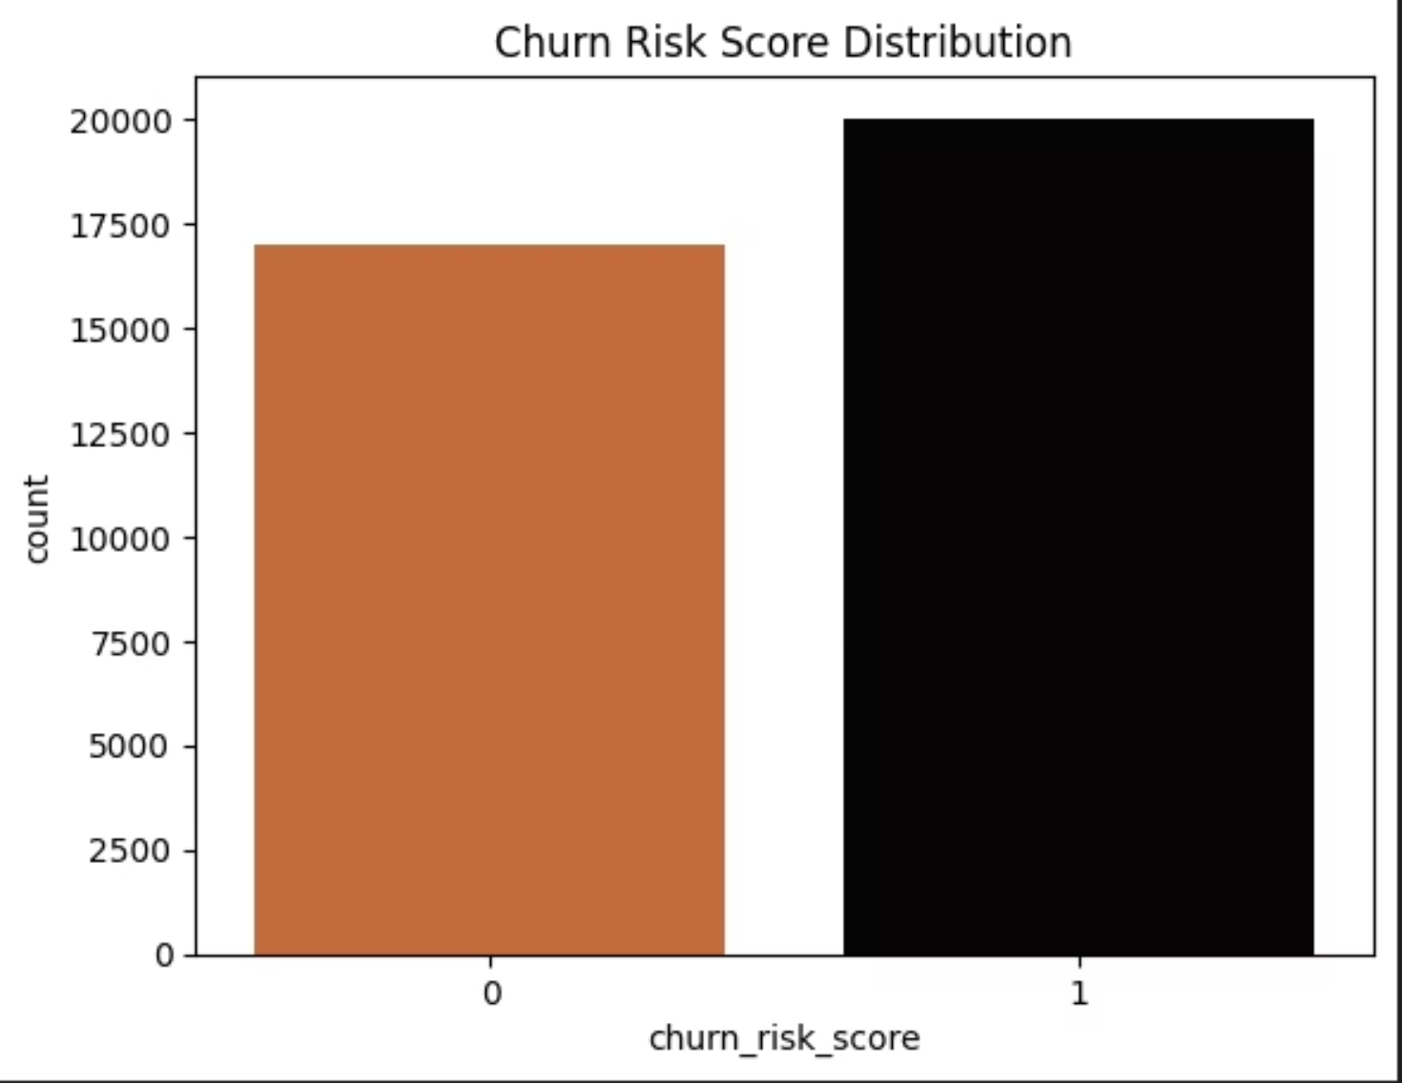
Data Understanding (Target Distribution)
Target Variable Balance
The visualization reveals the distribution of customers across churn risk categories, providing critical insight into the overall customer base health.
1
0
At Risk
Stable
Customers likely to churn
Customers likely to stay

Slide 9

Data Understanding (Target Distribution)… cont…
Key Finding: Churn Risk Distribution
The analysis of the churn risk distribution shows that customers in category 1, representing those at risk of leaving, slightly outnumber those in category 0, who are not at risk. This finding implies that more customers are vulnerable to churning than those likely to remain loyal.
Business Implications
Revenue Risk
Strategic Priority
Retention Focus
The potential revenue loss from at-risk customers could be significant, threatening long-term business sustainability and growth prospects.
This highlights the urgency of implementing proactive churn management strategies to address the imbalanced risk profile.
Prioritizing retention efforts toward category 1 customers is critical to sustaining profitability and strengthening overall customer loyalty.

Slide 10
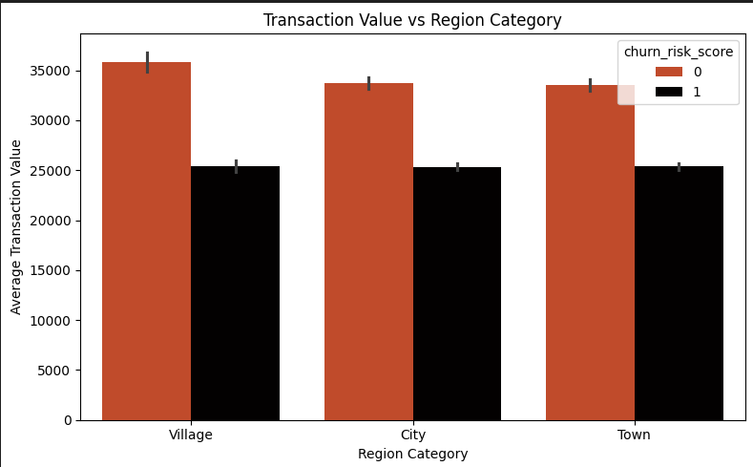
Data Understanding (Transaction Value vs Region Category)
Exploring the relationship between customer location and their transaction value reveals important patterns about customer segments across different regional categories.

Slide 11




Data Understanding (Transaction Value vs Region Category)… cont…
City Customers Follow
Town Customers Trail
Village Customers Lead
Customers from the village demographic record the highest average transaction value, suggesting this segment represents high-value users.
Town-based customers show the lowest transaction values, indicating different usage patterns or service needs.
Those in the city demographic show moderate transaction values, ranking second in average spending behavior.
Strategic Opportunities
This suggests that rural customers may represent a more valuable segment in terms of spending behavior, potentially offering ISPs an opportunity to tailor premium packages or targeted retention strategies for this group, while also exploring ways to boost engagement and transaction values among city and town customers through customized offerings.

Slide 12
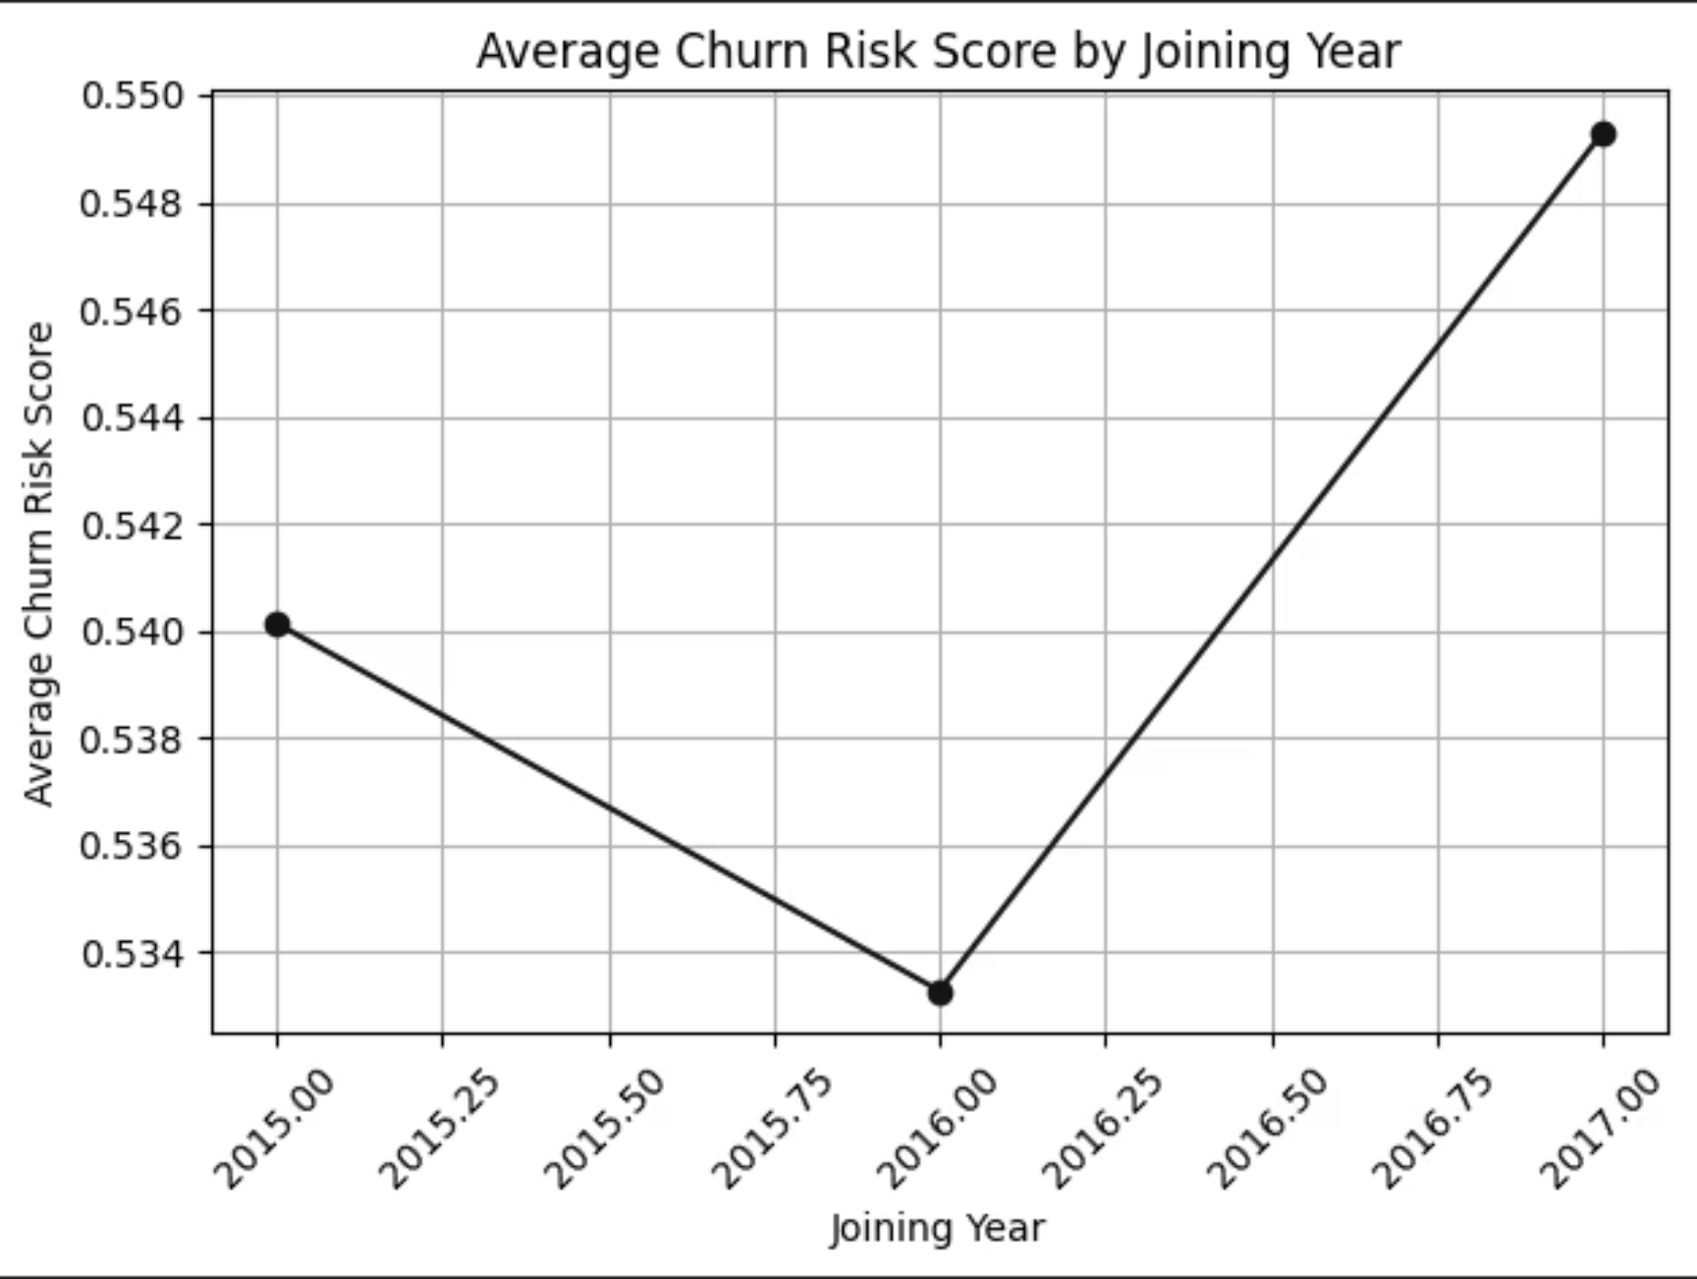
Data Understanding (Average Churn Risk Score by Joining Year)
Temporal Analysis
Examining how churn risk varies across different customer acquisition years reveals patterns about cohort behavior and loyalty trends over time.
Understanding whether joining year influences churn helps identify if certain acquisition periods produced more loyal customer bases.

Slide 13

Data Understanding (Average Churn Risk Score by Joining Year)
2015: Risk Decline
No Clear Trend
Churn risk score shows a notable decline
No consistent pattern emerges over time
1
2
3
2017: Risk Rise
Followed by an increase in churn risk
Key Insight
The churn risk score shows a decline in 2015, followed by a rise in 2017. However, there is no consistent upward or downward trend over the years, suggesting that the year of customer acquisition does not play a significant role in determining churn likelihood. This indicates that churn risk may be influenced more by other variables such as customer behavior, service quality, or demographic factors rather than the year of joining.
Recommendation: Further analysis focusing on months, seasons, or other time-based patterns could provide deeper insights into whether churn risk is affected by shorter-term temporal factors.

Slide 14
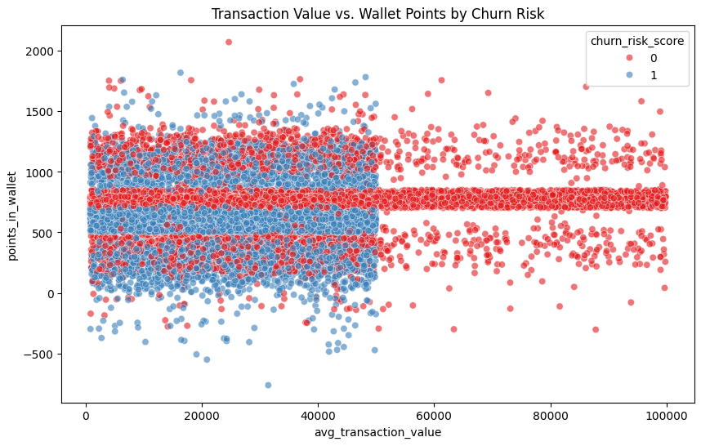
Data Understanding (Transaction Value vs Wallet Points by Churn Risk)
Analyzing the relationship between transaction values, wallet points, and churn risk reveals important patterns about customer engagement and loyalty program effectiveness.

Slide 15

Data Understanding (Transaction Value vs Wallet Points by Churn Risk)
Clustering Patterns
Transaction values range widely, but most customers cluster around 500 to 1,000 wallet points. Low-risk customers are concentrated at these thresholds, likely due to loyalty milestones, while high-risk customers are more dispersed. This suggests that encouraging structured wallet point accumulation could help reduce churn.
500
Lower Threshold
Wallet points clustering
1000
Upper Threshold
Wallet points clustering

Slide 16
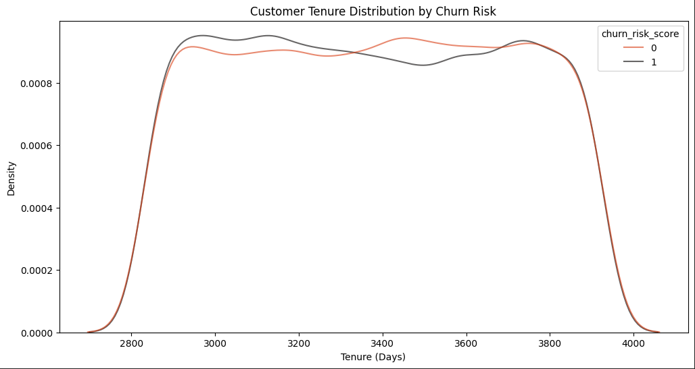
Data Understanding (Customer Tenure Distribution By Churn Risk)
The KDE (Kernel Density Estimation) plot visualizes how customer tenure relates to churn risk, revealing unexpected patterns about long-term customer loyalty.

Slide 17
Data Understanding (Customer Tenure Distribution By Churn Risk)
High-Risk Concentration
The KDE plot indicates that high churn-risk customers are concentrated between 2,800 and 3,000 days of tenure, representing a critical vulnerability period.
Low-Risk Distribution
Low-risk customers are more widely distributed across the tenure spectrum, suggesting varied loyalty patterns among stable customers.
Surprising Finding
Although longer tenure often signals loyalty, a subset of long-tenured customers still faces elevated churn risk, challenging conventional assumptions.
Strategic Implication
The overlap around 3,000–3,200 days suggests that tenure alone is not a reliable predictor of churn, highlighting the importance of combining it with behavioral factors such as complaints, engagement levels, and service quality metrics for more accurate predictions and targeted retention strategies.

Slide 18
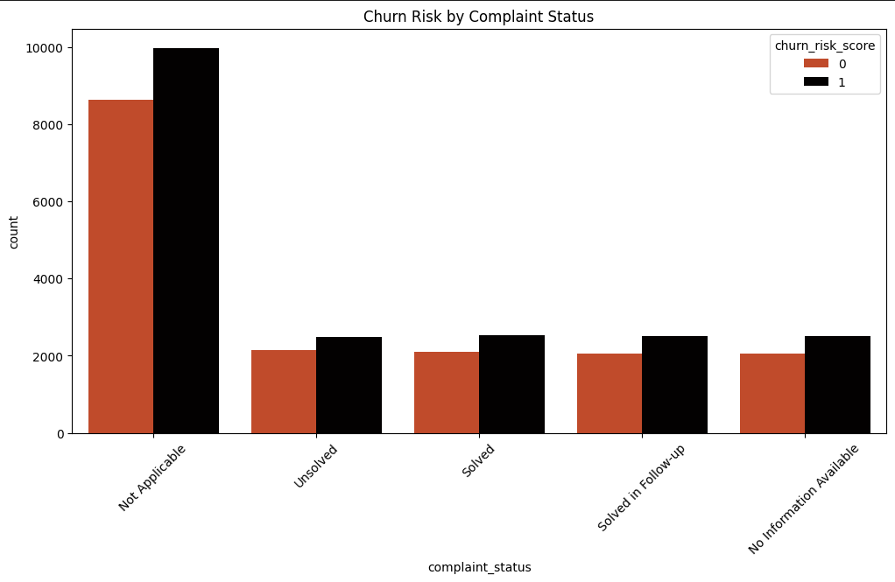
Data Understanding (Churn Risk by Complaint Status)
Examining the relationship between customer complaints and churn risk reveals critical insights about service quality impacts and resolution effectiveness.

Slide 19
Data Understanding (Churn Risk by Complaint Status)
Universal Elevated Risk
Most customers fall under the "Not Applicable" complaint status, suggesting they did not raise any complaints, yet even in this group, churn-risk customers outnumber those not at risk. Across all other complaint categories—whether "Unsolved," "Solved," "Solved in Follow-up," or "No Information Available"—the number of churn-risk customers is consistently higher.
Complaints Signal Risk
Resolution Gaps
Intervention Needed
The very presence of a complaint, regardless of resolution status, is strongly linked to higher churn risk across all categories.
The fact that churn remains elevated even when complaints are marked as solved suggests potential gaps in customer satisfaction or follow-up effectiveness.
This pattern indicates that ISPs need to improve not just complaint resolution but also post-resolution engagement to truly retain at-risk customers.

Slide 20
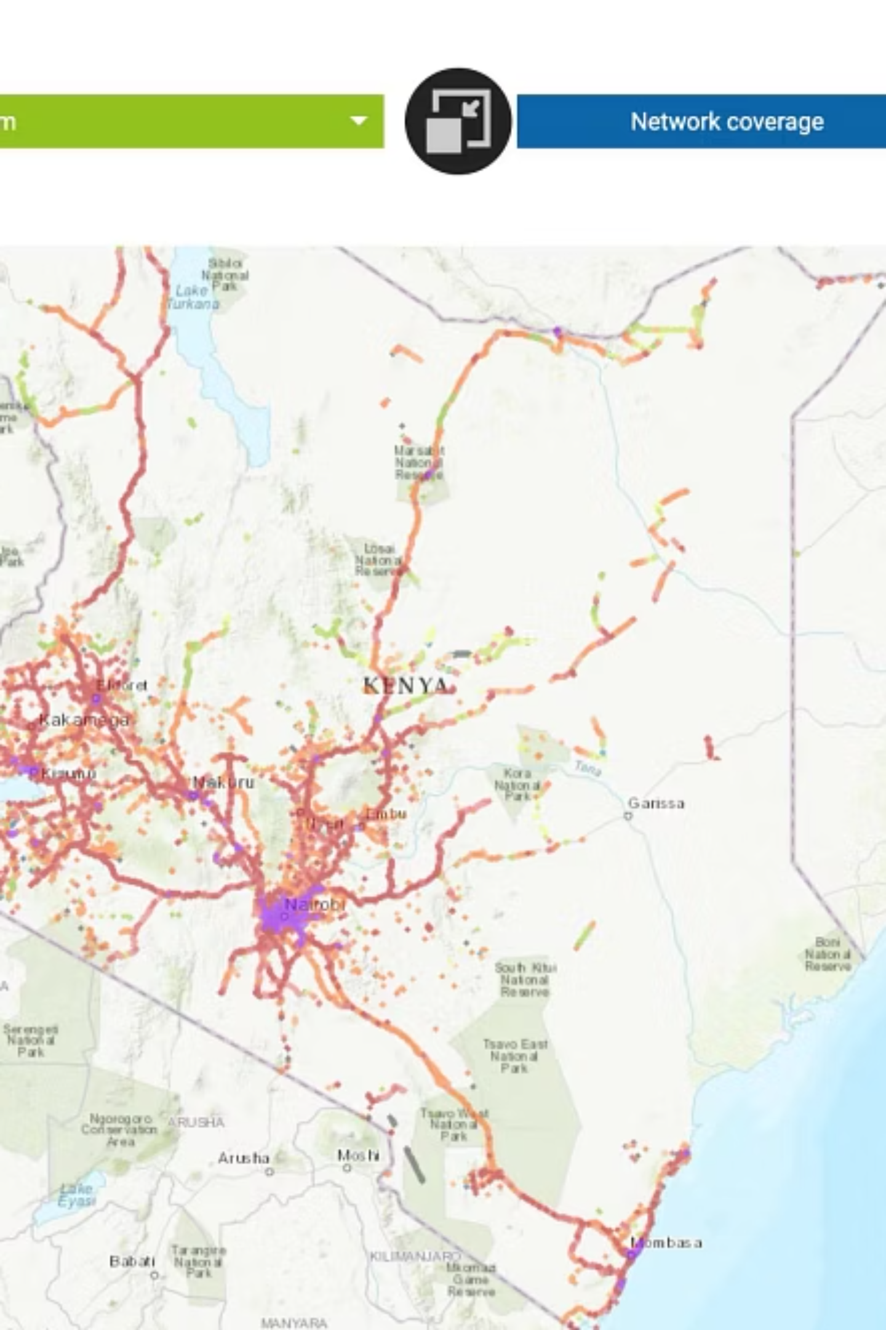
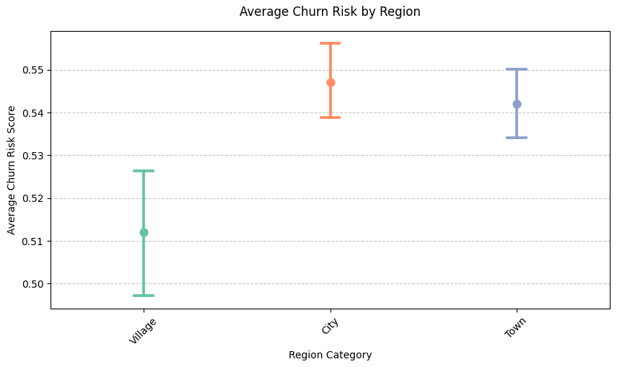
Data Understanding (Average Churn Risk By Region)
Geographic Churn Patterns
Analyzing average churn risk across different regions reveals important geographic variations that can inform targeted retention strategies and resource allocation decisions.
Understanding regional differences in churn risk enables ISPs to customize their approach based on local market conditions, infrastructure quality, and competitive dynamics.

Slide 21

Data Understanding: Average Churn Risk By Region
Customers in city regions exhibit the highest average churn risk, followed by those in towns, while villages report the lowest. The narrow confidence intervals suggest these differences are statistically significant, especially between city and village customers.
This pattern indicates that urban customers are more prone to churn, likely due to higher service expectations and greater availability of alternatives. These insights highlight the importance of developing location-based retention strategies that address the unique needs of different customer groups.

Slide 22
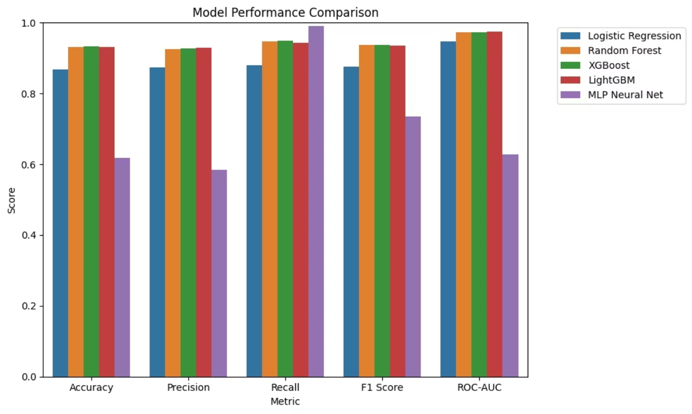
Data Analysis: Machine Learning Findings
Ensemble models (Random Forest, XGBoost, LightGBM) outperformed others, achieving ~93% accuracy and ROC-AUC >0.97. LightGBM showed the best overall balance.
Logistic Regression was decent but weaker on recall, while the MLP Neural Net underperformed despite its complexity.
The chart demonstrates the superior performance of tree-based ensemble methods in predicting customer churn with high precision and reliability.

Slide 23

Key Findings: ISP Churn Prediction
Churn Patterns
Complaints Matter
Engagement Signals
Basic members churn most (27%) vs. Gold (8%), and urban customers are 1.6x more likely to churn.
Customers with complaints—solved or not—remain twice as likely to churn, revealing gaps in satisfaction.
Wallet points strongly reduce churn (correlation = –0.47), but high-risk customers are less aligned with loyalty milestones.
Tenure Effect
Model Results
Long tenure usually implies loyalty, yet a subset of 2,800–3,000 days shows high churn, proving tenure alone is insufficient.
Ensemble models (Random Forest, XGBoost, LightGBM) outperformed others, achieving recall >85% and ROC-AUC ≈0.97.

Slide 24
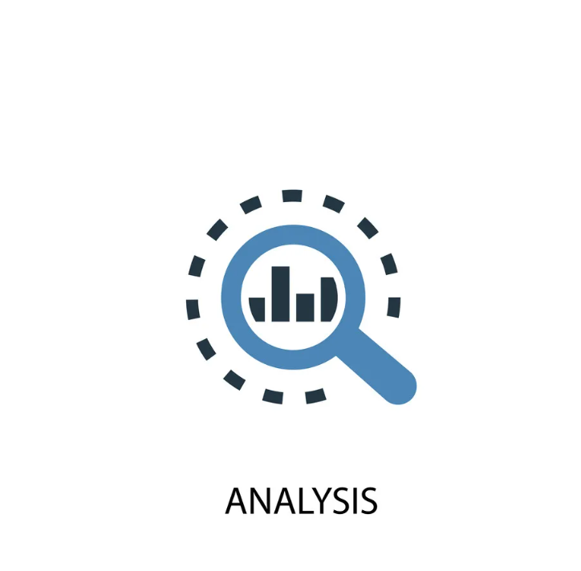
What the Model Does
Model Performance: Churn Prediction
01
What the model does
Predicts whether a customer is likely to churn or stay based on
their behavior and profile data.
02
Evaluation metrics used
Accuracy, Precision, Recall, F1 Score, ROC-AUC.
03
Key findings
Logistic Regression performed reasonably well but less than advanced models
Random Forest, XGBoost, and LightGBM achieved the best results with high accuracy and balanced precision/recall
Neural Network underperformed, showing lower recall despite high precision
04
Best models
Tree-based ensembles (Random Forest, XGBoost, LightGBM)
are most effective for churn prediction.

Slide 25






Uses of Key Findings
Targeted Retention
Complaint Management
Focus loyalty offers and upgrades on high-risk customer groups (e.g., Basic and urban segments).
Use complaint data to trigger early intervention and improve post-resolution follow-up.
Engagement Boost
Geo-Marketing
Design gamified loyalty programs and reward thresholds to strengthen wallet-point participation.
Allocate marketing budgets strategically toward cities and towns with the highest churn risk.
Predictive Alerts
Continuous Improvement
Deploy the churn model to flag at-risk customers (churn probability > 0.65) for personalized outreach.
Monitor churn trends and retrain models quarterly for adaptive, data-driven decision-making.

Slide 26

Recommendations
1
Strengthen Retention Programs
Offer loyalty incentives that motivate Basic members to upgrade early.
2
Improve Complaint Handling
Set up a dedicated team to resolve issues quickly and personally.
3
Boost Wallet Engagement
Gamify rewards with streaks, points, and milestone bonuses.
4
Target Urban Customers
Run tailored retention campaigns in high-churn city areas.
5
Use Early-Warning Triggers
Send retention offers when churn probability exceeds 0.65.
6
Keep Models Updated
Retrain models regularly to reflect changing customer behavior.

Slide 27

https://s-909-a-machine-learning-approach-to-isp-churn-predi-app-btf75c.streamlit.app/

Slide 28


